Slide 1
TOPIC A:
DATABASES
LESSON A-11
DATABASE INTERACTION

Slide 2
AGENDA
Database Administrators
User Interaction with Databases
Database Recovery
Integrated Database Systems
NOTE!
Have a way to take notes available for this lesson

Slide 3

THE WARM UP QUESTION
A gym database needs to track members and the fitness classes they attend.
What is the relationship between members and classes in this database?
How should this information be stored?

Slide 4
THE WARM UP ANSWER
There is a many to many relationship between members and classes
Because of this, we need some sort of supporting table, perhaps called enrollment
Each class must have a member, but not each member must go to a class

Slide 5
DBA
Database Administrator is the person who oversees the database for an organization
Think of them like the boss but for this one specific program
They also sometimes have people that work under them

Slide 6
DBA
Database Administrators are responsible for:
Data security & access control
Backup and recovery
Performance tuning
Maintenance & updates
User account management

Slide 7
DBA
While this may be relatively minor for certain organizations, DBAs can be vital to security of data
Hospitals
What information is sensitive?
Schools
Banks

Slide 8
USER INTERACTION
For a user to interact with a database we have a handful of options
SQL queries
QBE (Query by Example)
Natural Language

Slide 9
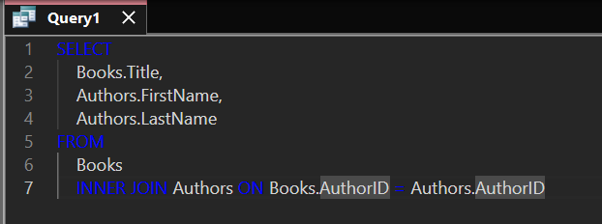
SQL QUERIES
SQL queries are written in SQL (woah)
It’s the most technically complex way of doing it, but it can be very quick if you’re experienced

Slide 10
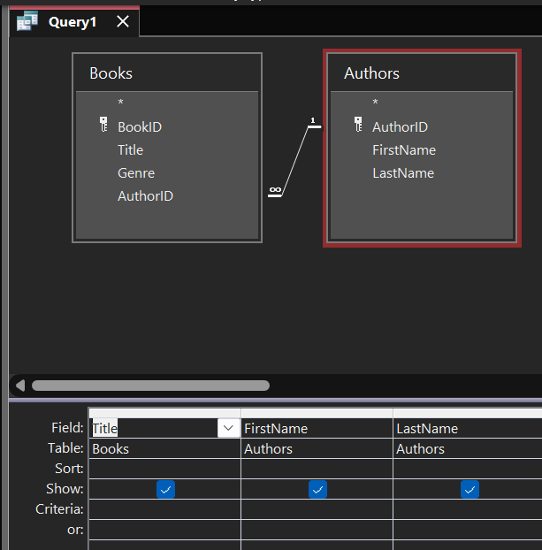
QBE QUERIES
Query-by-example queries are much more visual
This can be useful for people who are less comfortable writing code
Also good for people who have trouble using keyboards
What principle is this?

Slide 11
NL QUERIES
Natural language queries are just verbal ways of describing queries…
They don work on databases
BUT
Because we have LLMs now we can convert NL queries to SQL queries
Yippee for AI!

Slide 12

DATABASE BACKUP
The DBA is in charge of ensuring that database backups are made regularly
As we discussed way back in topic 1, we can copy our database to another location for backup
We can restore from the backup if anything goes wrong with the original

Slide 13
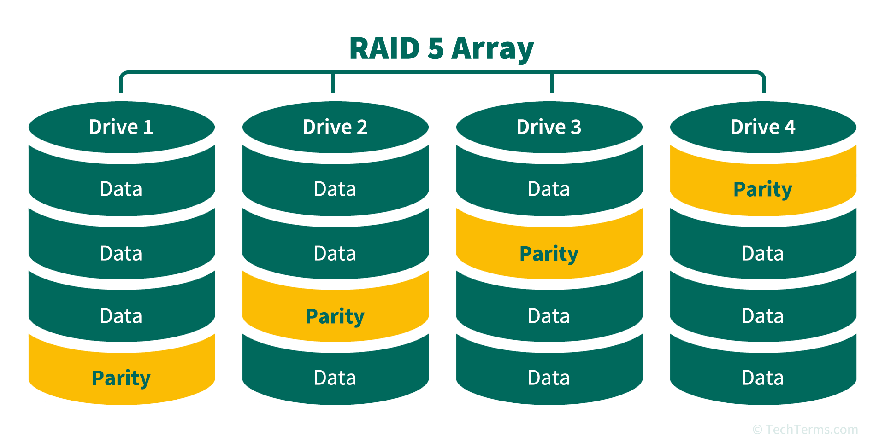
DATABASE BACKUP
When it does crash:
Keeping a transaction log can help us identify what the problem was
In the event of a drive failure, configuring the storage drives in RAID will help to recover the other drives
Refresh topic 2 if RAID is unfamiliar

Slide 14
ROLLBACK VS ROLLFORWARDS
In the event of a database crash, we have two options
Rollback to the last known safe state
OR
Rollforwards and apply missed transactions that were attempted while database was down
What do you think is best?

Slide 15
ROLLBACK VS ROLLFORWARDS
Is it worth spending $5000 on a backup system for a $10000 business?
What are possible alternatives?
Does it matter based on what the data is?

Slide 16
DATABASE INTEGRATION
But of course, none of this matters if the database isn’t useful to us
Integration means that multiple systems share and access the database in real time
What systems would be interacted with when a customer places an order at an online store?

Slide 17
DATABASE INTEGRATION
How does a college’s StudentID field link to all of the following subsystems?
Grades
Attendence
Financial Aid
Library

Slide 18
DATABASE INTEGRATION
This of course does come with its own issues
Data might end up being duplicated for convenience’s sake
What might this violate (break)?
Does every subsystem at a school need to know your financial aid status
How much money and time would it take to set up a complex system such as this?

Slide 19
DISCUSSION
Who owns the data in an integrated system – the individual or the organization?

Slide 20

VOCAB TO REMEMBER
Database Administrator
Backup
Restore
Rollback
Rollforwards
SQL Query
QBE Query
NL Query

